Slide 1

Supporting success in maths
How To Help At Home

Slide 2
Knowing what to focus on
Students will have lists of topics areas they need to focus their revision on:
  Pre-unit test revision list
  Unit test analysis sheet (green sheets stuck in their books)
  Revision packs with topic list (with hyperlinked video tutorials – new this year)
  Teacher feedback in their exercise books
  Mock analysis sheet
  PiXL MathsApp ‘Skills Overview’
Please ask students to focus on ‘Red’ areas rather than trying to revise everything

Slide 3
How should students revise
Support students to plan when and where the revision will be done
“The only way to learn Mathematics is to do Mathematics”
Set aside 15-20 minutes, four times a week to some Mathematics (short sharp bursts)
Use the gap analysis tools (either from test analyses or PiXL MathsApp) to prioritise specific areas to focus on
Use the therapy resources on MathsWatch, PiXL MathsApp and Corbett Maths
Encourage the use of flash cards or mindmaps as reminders of weak areas

Slide 4
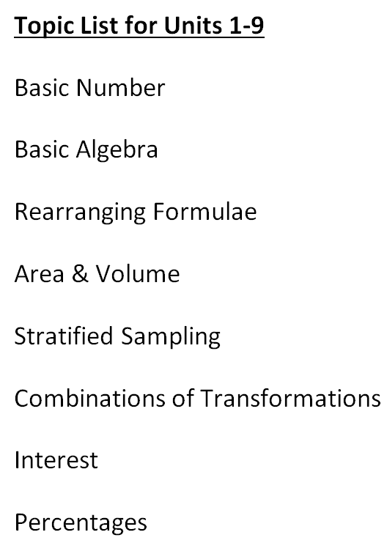
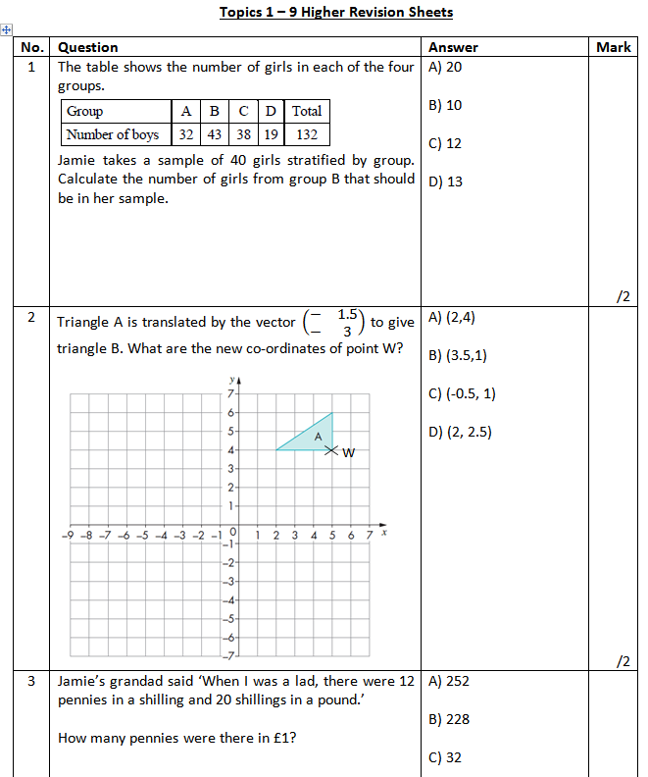
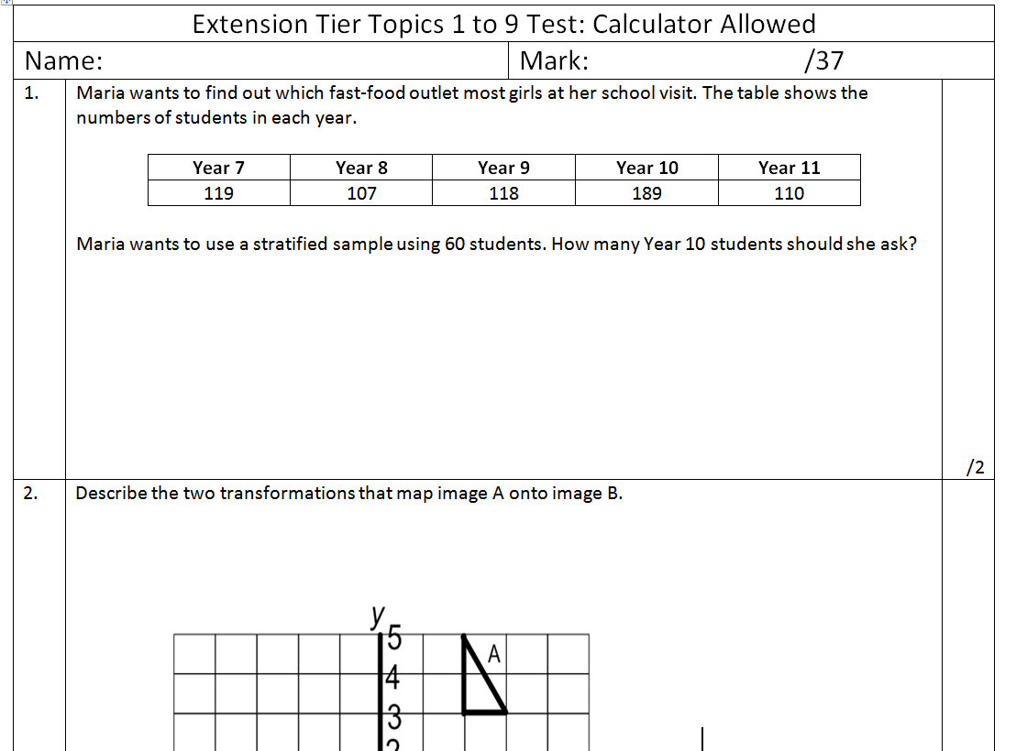
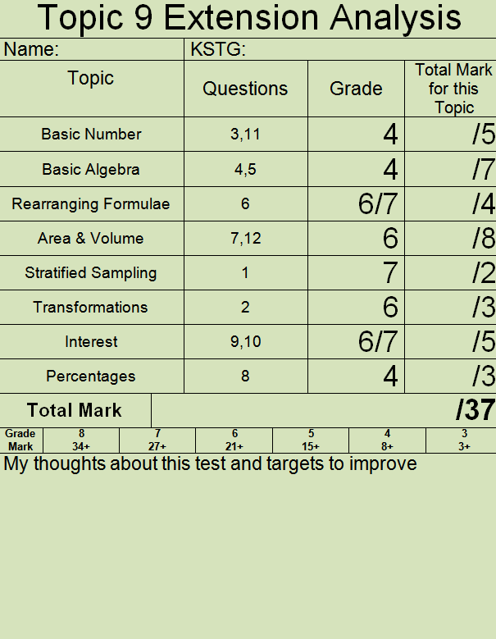
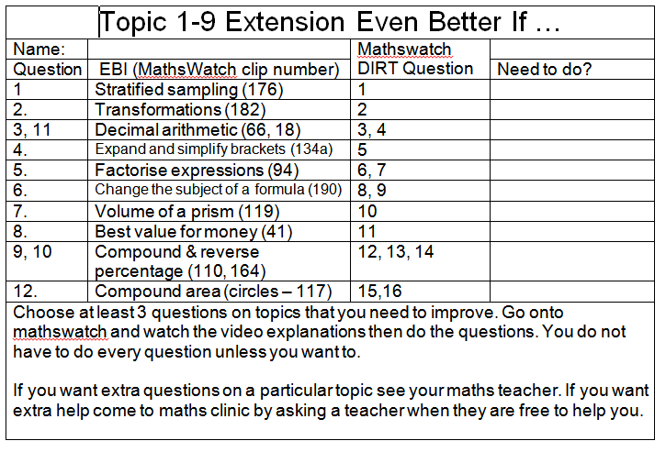
Cumulative testing resources
Revision list
TEST
Practice homework
Even Better If – therapy and re-test
RAG analysis

Slide 5
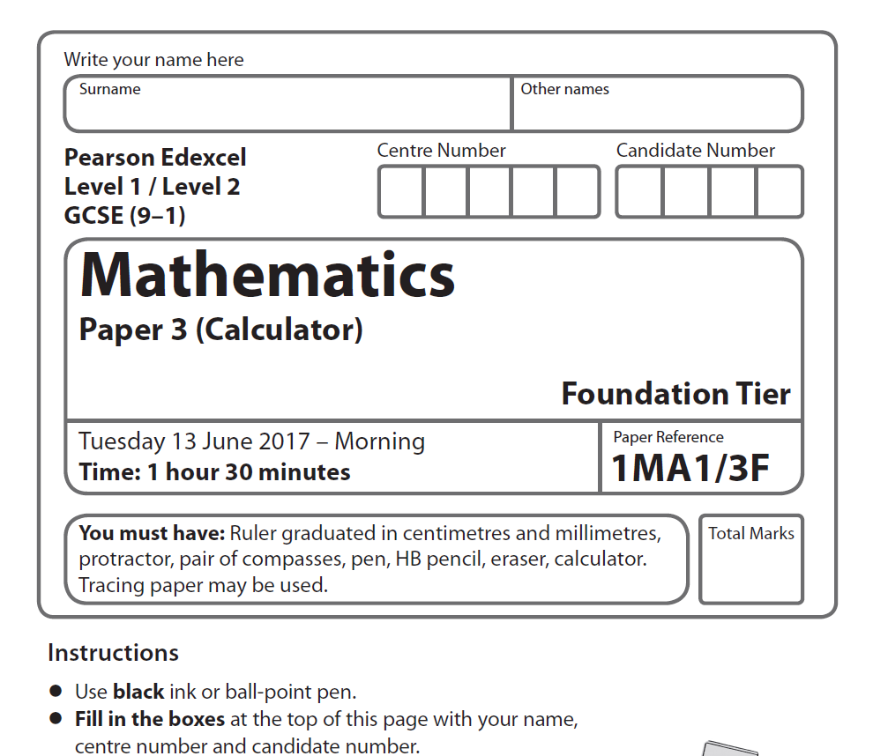
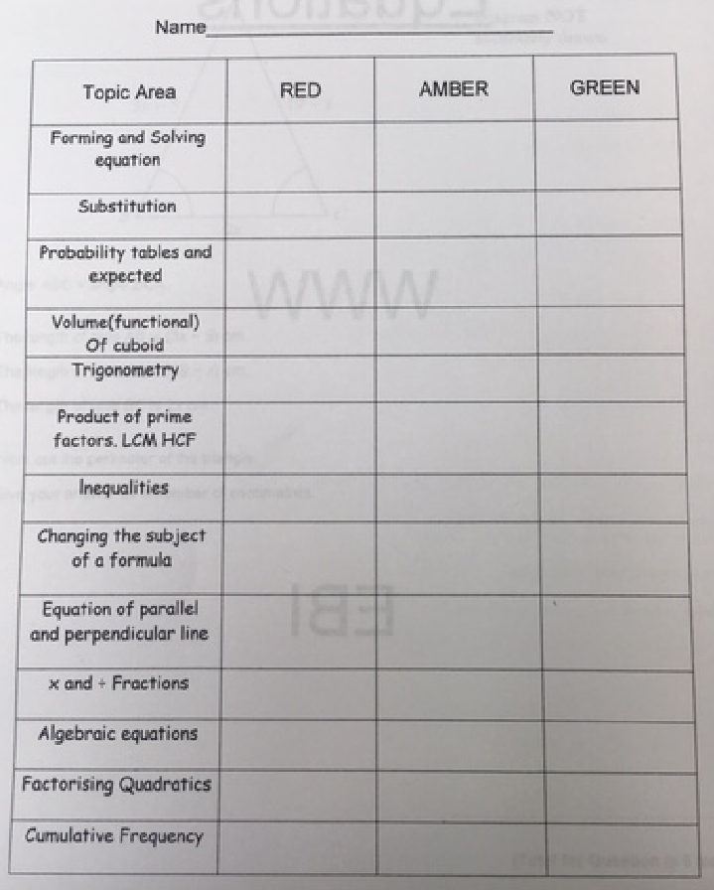
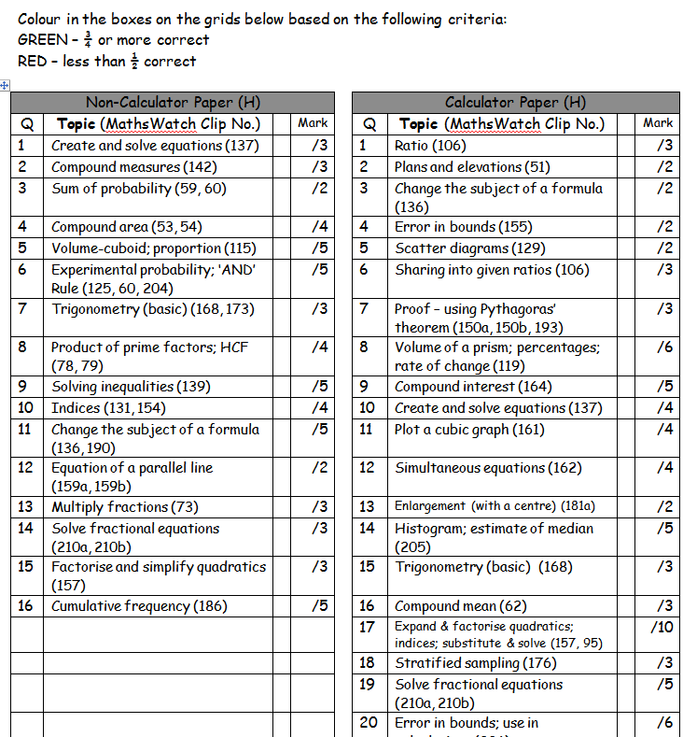


Mock Exam process
Revision list and question pack
EXAM
Therapy and re-test
RAG analysis

Slide 6
Mathswatch vle
Online resource – video tutorials and worksheets
Username: ‘student school username’@fbaok
Password: hexagon
Suggestions:
  15-20 minutes per session
  Encourage full working out
  Use calculator (if appropriate)
  Make a ‘flashcard’ or ‘mindmap’ if needed

Slide 7
PiXL Maths app
Online resource – video/powerpoint therapy materials; self marking questions; updated RAG skills analysis
School ID: FB2562
Username: initial and surname e.g. AOTHER Password: same as username, e.g. AOTHER
Suggestions:
  15-20 minutes per session
  Encourage full working out
  Use calculator (if appropriate)
  Make a ‘flashcard’ or ‘mindmap’ if needed
  Monitor usage

Slide 8
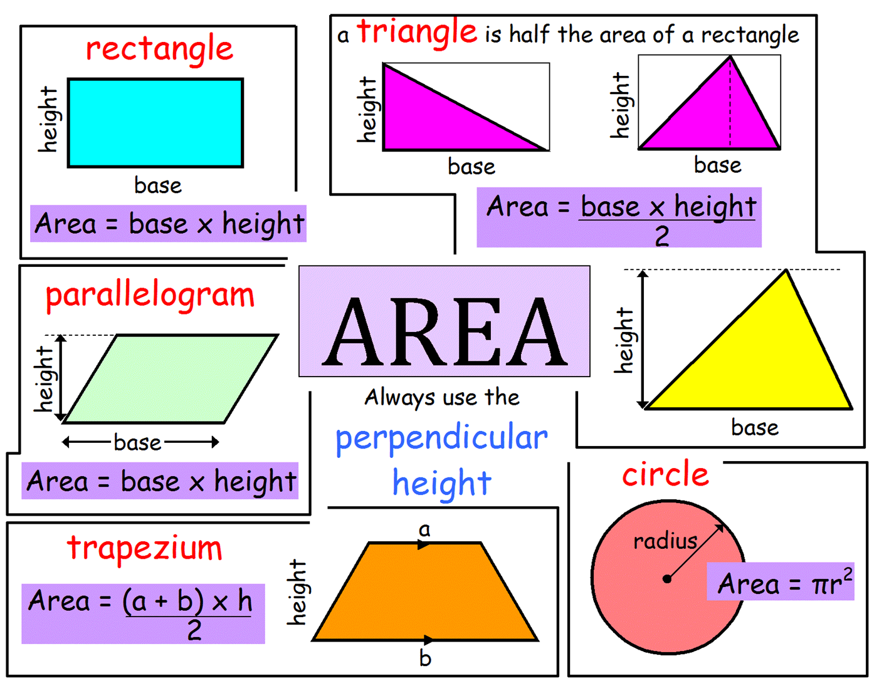
Examples of mindmaps / flashcards

Slide 9
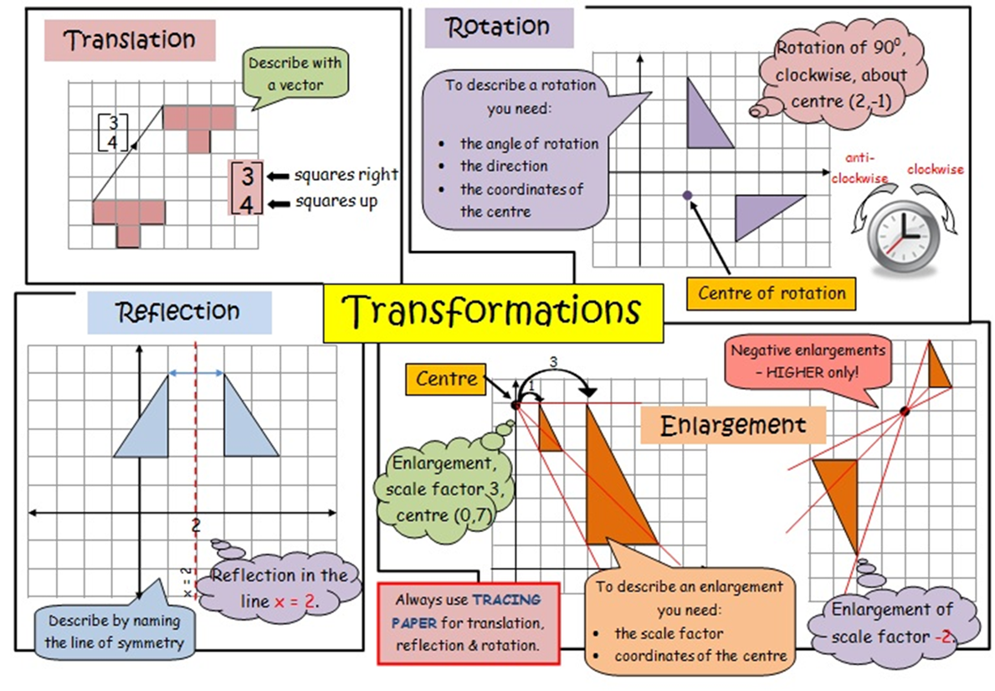
Examples of mindmaps / flashcards

Slide 10
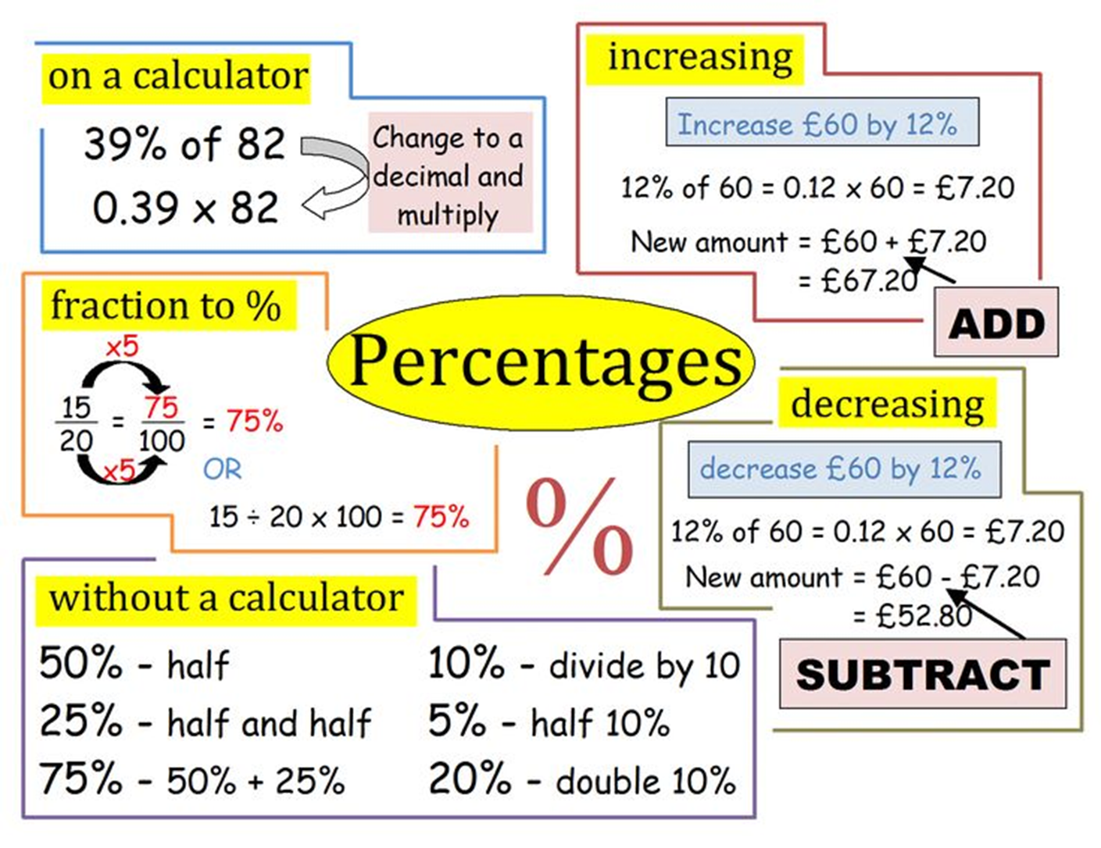
Examples of mindmaps / flashcards

Slide 11
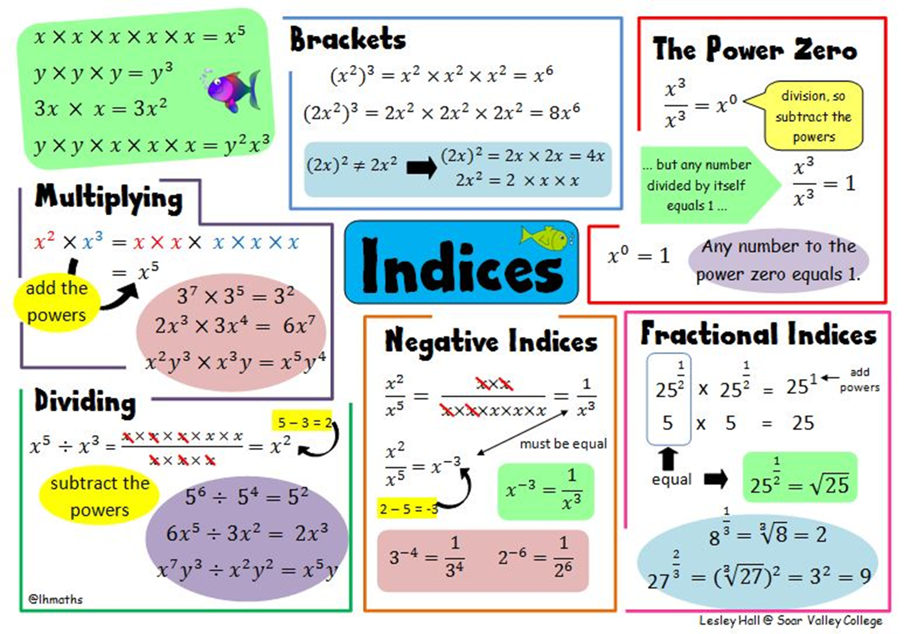
Examples of mindmaps / flashcards

