Slide 1
Revision Techniques Supporting your Daughter

Slide 2
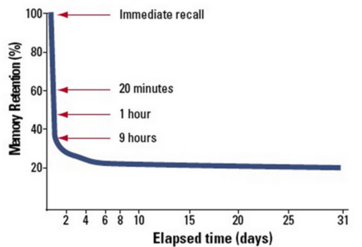
Memory Curve
After 24 hours you're likely to retain just 35% of the information you revised the previous evening. Furthermore, after 31 days you only remember approximately 20% of subject content.

Slide 3
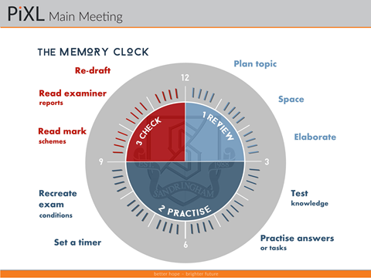
Revision Clock

Slide 4
Why?
It is important that students review, practice and check.
Students need to plan what they are actually revising, not just Maths e.g. algebra
When practising, set timers and stick to it. Recreating exam conditions can also help.
When checking, check against mark schemes, ask teachers/friends to look over the answers and give you feedback.
Re drafting answers is also helpful.

Slide 5
Revision technique 1: Flash Cards
Choose a topic / word (students to use their text books or revision guides for cues) and write this on one side of the card
Read the relevant part of their textbook or notes.
Students to then go back to their cards and try to write keywords, notes or definitions on them (this tests their memory)
Why? Summarising knowledge is a really good way to test what they know
Students can then flick through the cards to help them remember or use them to get friends/parents to test them.

Slide 6
Revision technique 2: Mind Maps
Mind mapping is one of the best ways to capture thoughts and bring them to life in visual form.
Mind maps can help students become more creative and remember more.
A mind map is basically a diagram that connects information around a central subject.
The combination of words and pictures is 6 times better than words alone.

Slide 7
Revision technique 3: Pod Casts
If you daughter loves listening to music this might be the best way for them to revise.
Students can record themselves speaking their work. They will be amazed how quickly it will go in. when you think about how quickly you remember song lyrics.
There are also podcasts that can be downloaded for various subjects.

Slide 8

Revision technique 4: Song Lyrics
If your daughter loves singing or listening to music this is a great way to revise. Although, I would not recommended this as their only form of revision.
They should think of catchy songs, or songs that they listen to a lot and change the lyrics to fit different topics.
Every time they hear the song they will remember the lyrics you have changed. It really does work.

Slide 9
Revision technique 5: Q and A
Instead of just reading notes, students should read and answer questions. The best way to do this is to look for answers to previous exam answers.
Timing is important, parents can help with this. This will also help them with making sure they have the timings correct for the exam, as well as helping to increase their handwriting speed and their ability to think and write under pressure.

Slide 10
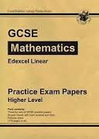
Revision technique 5:Past Papers and questions
Students can ask teachers for past exam papers/questions. There are also some websites where you can download these. Find out how many minutes they need to spend on each question and time them.
Mark schemes could be used to mark these, or their peers, or asking teachers to mark them.

Slide 11
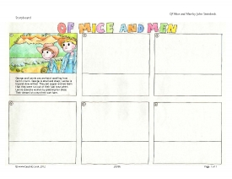
Revision technique 6: Storyboard
For those who have daughters who are artistic and creative.
They can draw storyboards of key events/sequences.
In the exam they will be able to visualise this.

Slide 12
Revision technique 7:Post it notes
This works really well when revising languages. Put the French/German word on objects at home.
Das Wohnzimmer
La chambre
Der Wasserhahn
Le robinet
Der Mülleimer
La poubelle

Slide 13
Revision technique 8: Revision Websites and videos
There are lots of good revision websites available.
If your daughter is someone who is likely to check Twitter/ Facebook/instagram etc. instead then this might not be the best method for them.
http://www.bbc.co.uk/schools/gcsebitesize
www.mymaths.co.uk
https://www.youtube.com/watch?v=JC82Il2cjqA
http://www.sparknotes.com/video/

Slide 14
Revision technique 9: Apps
Pixl Apps
Pixl Maths and English Lit apps are available free to students. They are launching Geography and History on the 22nd September. We will be subscribing to these also.
Edexcel Past Papers
http://www.educationalappstore.com/app/edexcel-past-papers

Slide 15
Revision technique 10: Twitter
GERMAN
German should be fun @LearnXDGerman German phrases followed shortly after by the English translation.
Jabba German @JabbaGerman Daily German words, phrases and games
DW learn german @dw-learngerman
Learn 10 German @learn10german
Learn German @MyLinguaDE
FRENCH
French Today @frenchToday
Radio Lingua French @learnfrench
Learn 10 French @learn10french
Learn French today @french_learner
Business Studies
Business Studies @DHSBusiness Exam tips, techniques and business related information
Tutor2u Business @tutor2ubusiness Free resources to help you revise
Business Studies @KingEdBiz

